Slide 1
Global Sequence Alignment project
Tobi Azeez

Slide 2
Introduction
The first step to creating a sequence alignment algorithm was to figure out some general ideas of where to begin. The biggest hurdle in this project from the get go that I knew would be difficult was creating alternate alignments. But to start from scratch, let's look at the basics which means matches, mismatches, and gaps
After doing some basic research, I found a good youtube video that provided the basic theory behind how generic sequence alignment tools work - but one that didn't give any actual code to copy or paste (https://www.youtube.com/watch?v=jqyfhFziDjw&t=2847s&ab_channel=AhmetSacan)
The first step would be to create a 'game board', that is a matrix with your unique target and query strings as rows and columns. In this matrix, if two of the letters of each string are the same, a 'match score' is added into that cell of the matrix. If they are not the same, a 'mismatch score' is added instead

Slide 3
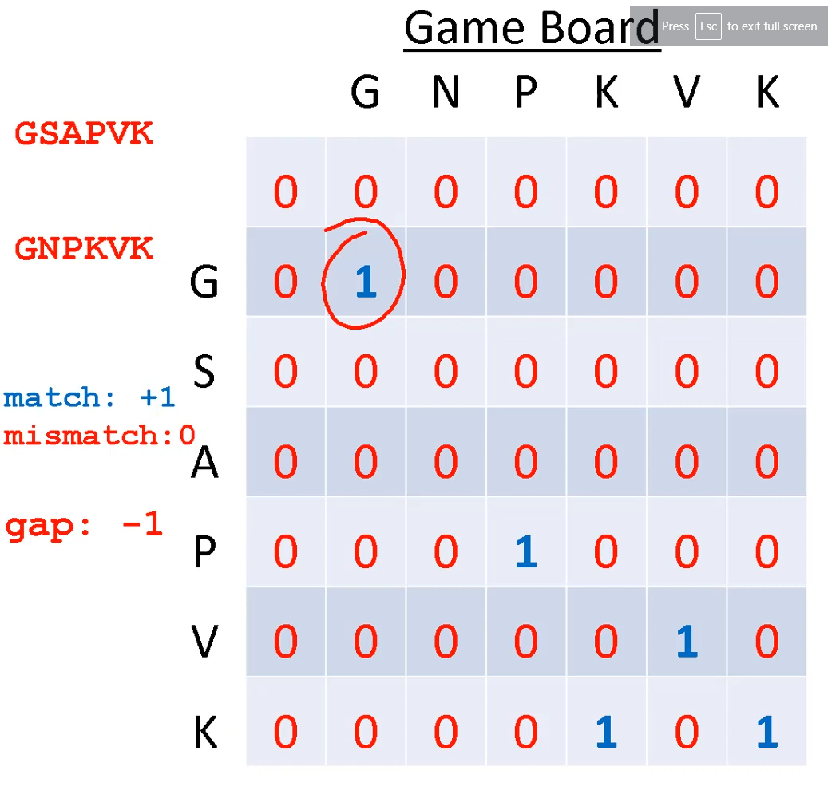
Creating the Game Board
Right is an example of what this game board should look like. I will use the same target and query strings as this above example for now, to show that it works as intended.

Slide 4
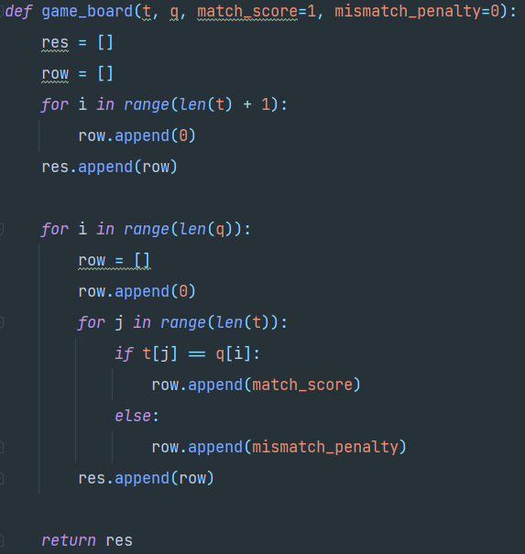
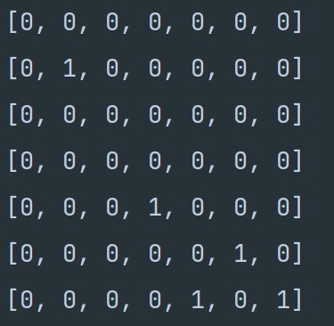
Game Board Code

Slide 6
Dynamic Programming Table
The second step is to create a 'dynamic programming table'. The way we do this is by moving through every element in the game_board, row by row. If we move from left to right, we decrease the value in the game_board by whatever our gap_penalty is defined to be. The same is true if we move from top to bottom.
However, if we move diagonally down, we get to 'collect' whatever value is in that same position of the game board. The way we choose what way to move is either due to necessity (if there are no other possible moves) or whichever move yields the greatest value. If there are multiple moves that yield the same max value, we will save both as different choices.

Slide 7
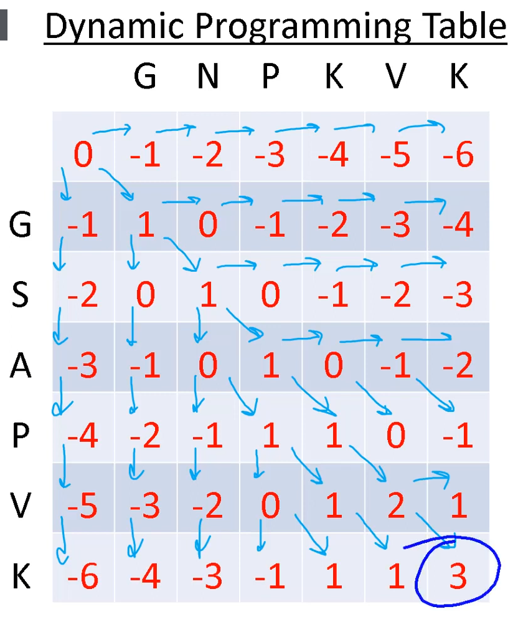
This example does not deal with multiple possibilities, but my code does

Slide 8
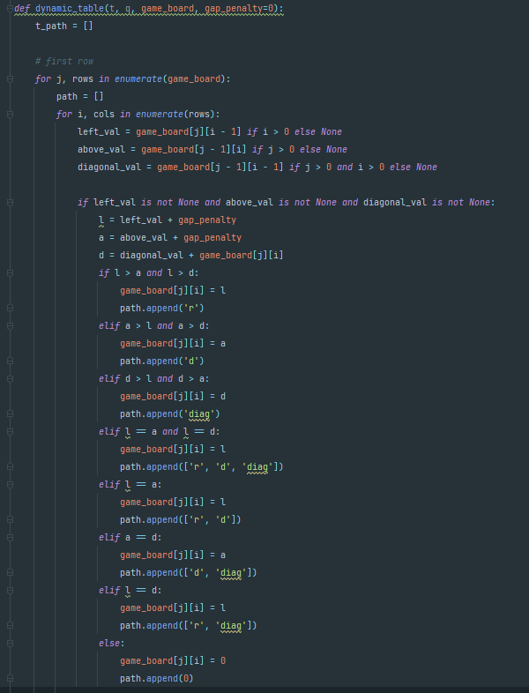
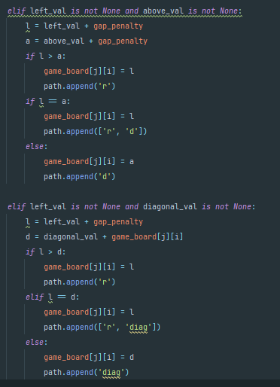
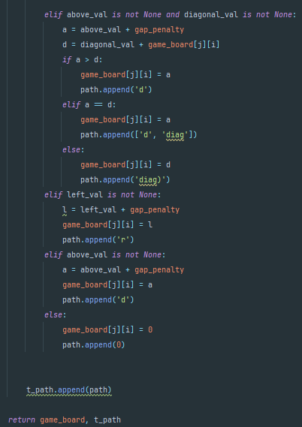
Covering all possible positions and conditions of which values to append, and save into path at each step

Slide 9
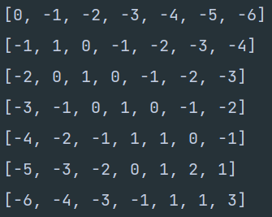

Slide 10
Tracing Back
Although the dynamic programming table is important, the most important thing from this process was the path variable. This saved the directional choices which will allow us to trace back and reassemble our alignment. The path matrix also any multiple alignment options that will yield the same overall score (score is the value in the bottom left of the dynamic programming matrix)

Slide 11
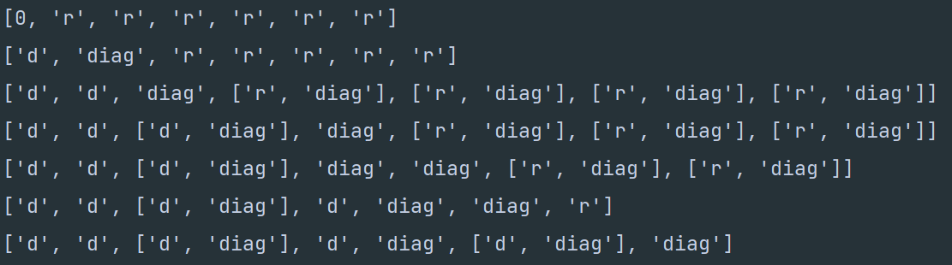
Path Matrix
Whilst there are multiple options for some cells in the matrix here, using a match score of 1 and a gap penalty of -1 (as we have been doing), there is only one best alignment, although it is difficult to visually trace back. An ‘r’ means we came from the left, ‘d’ means we came from above, and ‘diag’ means we came diagonally above and to the left

Slide 12
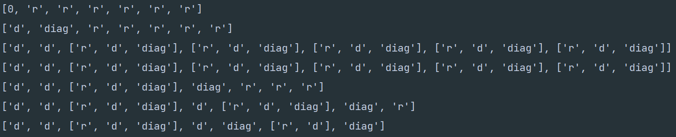
Path Matrix of Multiple Alignments
If we change the gap penalty from -1 to 0, this path matrix yields 5 possible alignments in comparison to only one. When using BLAST for example, the default settings are 1 for a match, and -2 for a mismatch. Gap penalty by default is left at 0. This can easily be customized.

Slide 13
The Alignment Algorithm
The final step is to trace back through our path matrix. Started at the bottom right, checking what each value is there, and following it, while assembling two new strings (x and y) which will have a dash any time a gap is present. There also may be multiple different alignments. These are shown as list elements in one cell. In order to explore all of the different possibilities, we will recursively go through each item, and save each unique alignment into a list. We can pull each item from this list later to look at all of these alignments together.

Slide 14
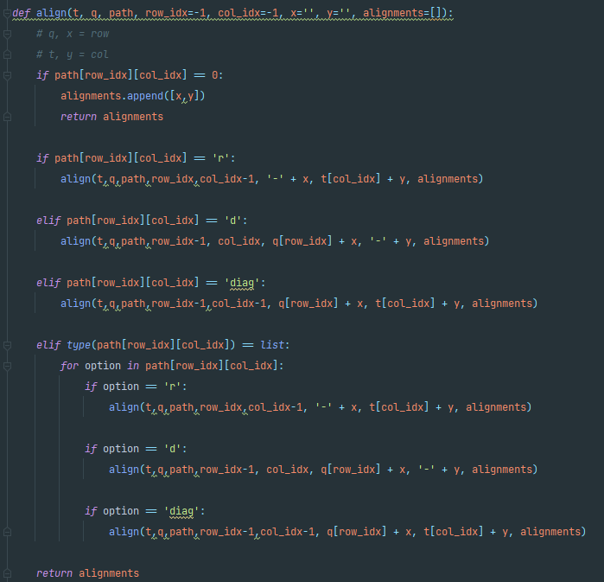
Our base case is if we have reached the start of the path matrix, which instead of having ‘r’ or ‘d’ or ‘diag’ will just have a 0.

Slide 15
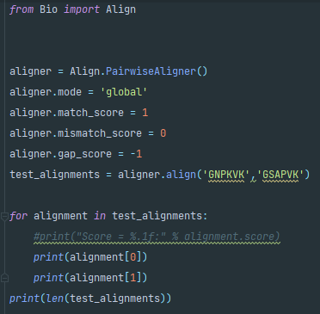

Checking our work
In order to make sure we have done everything correctly, we will use an already developed tool to cross check our work with. This tool is from the ‘Bio’ module and is named ‘Align’. Running this tool on the same strings as above yields the following unique alignment.
This isn’t so interesting as there is only one unique alignment, so let’s change the score parameters and look again

Slide 16
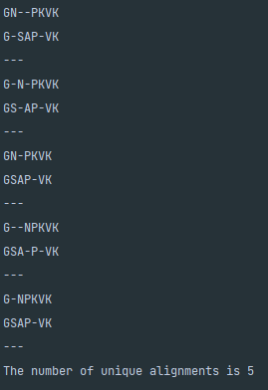
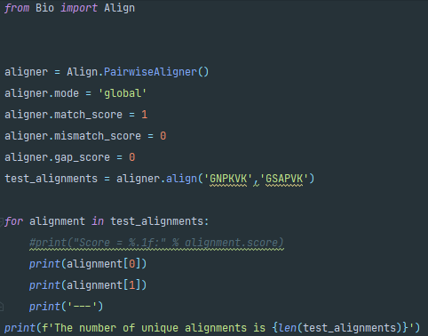
Setting Gap Penalty to 0
After changing the gap score to 0, there are now 5 possible best alignments. Let’s see if our code matches up the same

Slide 17
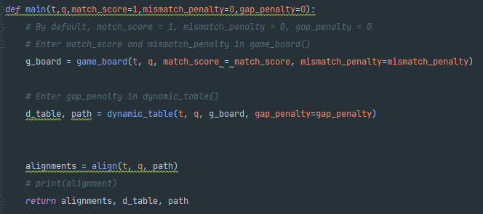
Testing our code
We’ll create a main() function to nicely wrap everything together.

Slide 18
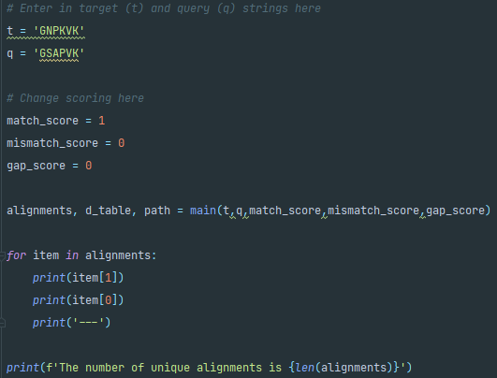
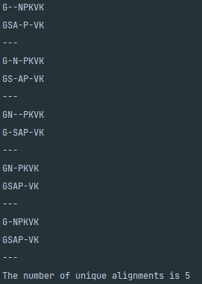
Testing our code
output
And by calling main…

Slide 19
Visual comparison
Although initially our result looks different, it is indeed the same but in a different order
Test code
Our code

Slide 20
Cross Check Function
It’s not feasible to check alignments visually in this way. When working with an actual string from a genetic sequencing experiment, there could be thousands of possible alignments. So, we can quickly make a function that just checks to see if each item from test alignment shows up in our alignment list.

Slide 21
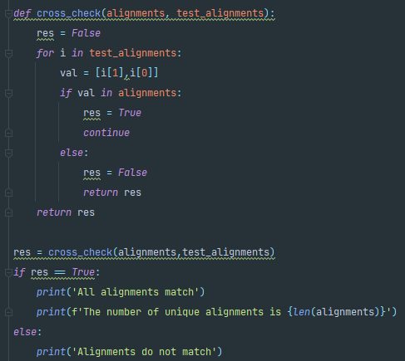

Cross Check contd.

